Slide 1
Chapter 9: Object-Relational Databases
Nested Relations
Complex Types and Object Orientation
Querying with Complex Types
Creation of Complex Values and Objects
Comparison of Object-Oriented and Object-Relational Databases

Slide 2
Object-Relational Data Models
Extend the relational data model by including object orientation and constructs to deal with added data types.
Allow attributes of tuples to have complex types, including non-atomic values such as nested relations.
Preserve relational foundations, in particular the declarative access to data, while extending modeling power.
Upward compatibility with existing relational languages.

Slide 3
Nested Relations
Motivation:
  Permit non-atomic domains (atomic ≡ indivisible)
  Example of non-atomic domain: set of integers,or set of tuples
  Allows more intuitive modeling for applications with complex data
Intuitive definition:
  allow relations whenever we allow atomic (scalar) values — relations within relations
  Retains mathematical foundation of relational model
  Violates first normal form.

Slide 4
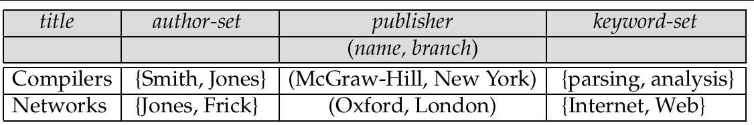
Example of a Nested Relation
Example: library information system
Each book has
  title,
  a set of authors,
  Publisher, and
  a set of keywords
Non-1NF relation books

Slide 5
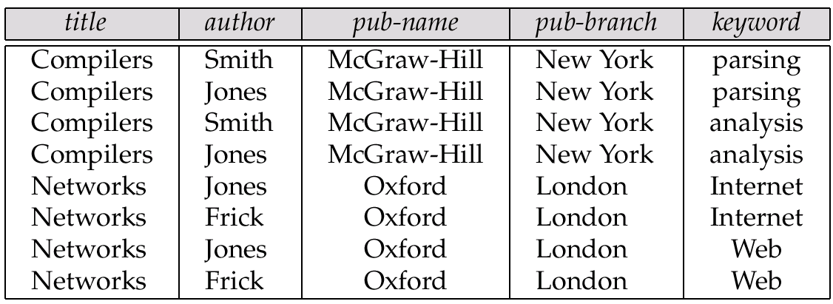
1NF Version of Nested Relation
1NF version of books
flat-books

Slide 6
4NF Decomposition of Nested Relation
Remove awkwardness of flat-books by assuming that the following multivalued dependencies hold:
  title author
  title keyword
  title pub-name, pub-branch
Decompose flat-doc into 4NF using the schemas:
  (title, author)
  (title, keyword)
  (title, pub-name, pub-branch)

Slide 7
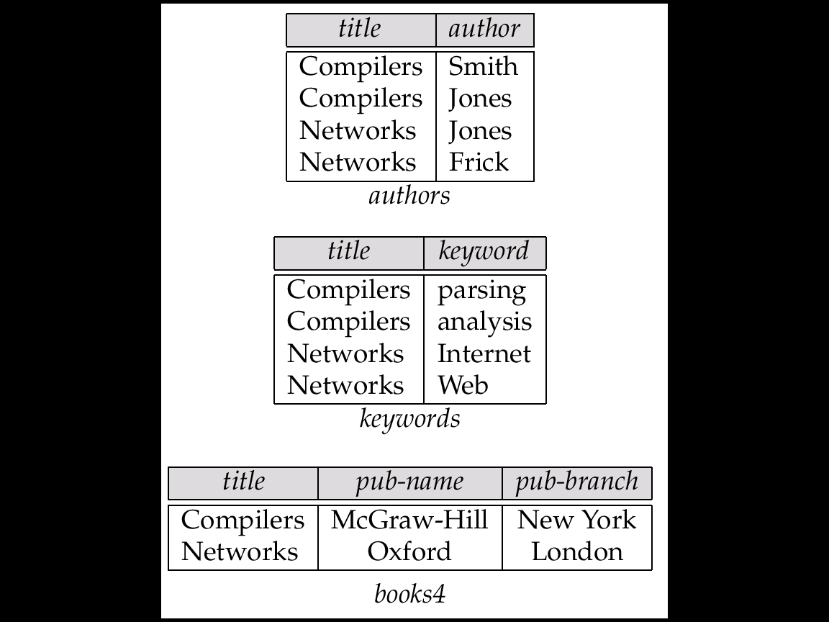
4NF Decomposition of flat–books

Slide 8
Problems with 4NF Schema
4NF design requires users to include joins in their queries.
1NF relational view flat-books defined by join of 4NF relations:
  eliminates the need for users to perform joins,
  but loses the one-to-one correspondence between tuples and documents.
  And has a large amount of redundancy
Nested relations representation is much more natural here.

Slide 9
Complex Types and SQL:1999
Extensions to SQL to support complex types include:
  Collection and large object types
    Nested relations are an example of collection types
  Structured types
    Nested record structures like composite attributes
  Inheritance
  Object orientation
    Including object identifiers and references
Our description is mainly based on the SQL:1999 standard
  Not fully implemented in any database system currently
  But some features are present in each of the major commercial database systems
    Read the manual of your database system to see what it supports
  We present some features that are not in SQL:1999
    These are noted explicitly

Slide 10
Collection Types
Set type (not in SQL:1999)
create table books (
…..
keyword-set setof(varchar(20))
……
)
Sets are an instance of collection types. Other instances include
  Arrays (are supported in SQL:1999)
    E.g. author-array varchar(20) array[10]
    Can access elements of array in usual fashion:
      E.g. author-array[1]
  Multisets (not supported in SQL:1999)
    I.e., unordered collections, where an element may occur multiple times
  Nested relations are sets of tuples
    SQL:1999 supports arrays of tuples

Slide 11
Large Object Types
Large object types
  clob: Character large objects
  book-review clob(10KB)
  blob: binary large objects
image blob(10MB)
movie blob (2GB)
JDBC/ODBC provide special methods to access large objects in small pieces
  Similar to accessing operating system files
  Application retrieves a locator for the large object and then manipulates the large object from the host language

Slide 12
Structured and Collection Types
Structured types can be declared and used in SQL
create type Publisher as
(name varchar(20),
branch varchar(20))
create type Book as
(title varchar(20),
author-array varchar(20) array [10],
pub-date date,
publisher Publisher,
keyword-set setof(varchar(20)))
  Note: setof declaration of keyword-set is not supported by SQL:1999
  Using an array to store authors lets us record the order of the authors
Structured types can be used to create tables
create table books of Book
  Similar to the nested relation books, but with array of authors
  instead of set

Slide 13
Structured and Collection Types (Cont.)
Structured types allow composite attributes of E-R diagrams to be represented directly.
Unnamed row types can also be used in SQL:1999 to define composite attributes
  E.g. we can omit the declaration of type Publisher and instead use the following in declaring the type Book
  publisher row (name varchar(20),
  branch varchar(20))
Similarly, collection types allow multivalued attributes of E-R diagrams to be represented directly.

Slide 14
Structured Types (Cont.)
We can create tables without creating an intermediate type
  For example, the table books could also be defined as follows:
create table books
(title varchar(20),
author-array varchar(20) array[10],
pub-date date,
publisher Publisher
keyword-list setof(varchar(20)))
Methods can be part of the type definition of a structured type:
create type Employee as (
name varchar(20),
salary integer)
method giveraise (percent integer)
We create the method body separately
create method giveraise (percent integer) for Employee
begin
set self.salary = self.salary + (self.salary * percent) / 100;
end

Slide 15
Creation of Values of Complex Types
Values of structured types are created using constructor functions
  E.g. Publisher(‘McGraw-Hill’, ‘New York’)
  Note: a value is not an object
SQL:1999 constructor functions
  E.g.
  create function Publisher (n varchar(20), b varchar(20))
  returns Publisher
  begin
  set name=n;
  set branch=b;
  end
  Every structured type has a default constructor with no arguments, others can be defined as required
Values of row type can be constructed by listing values in parantheses
  E.g. given row type row (name varchar(20),
  branch varchar(20))
  We can assign (`McGraw-Hill’,`New York’) as a value of above type

Slide 16
Creation of Values of Complex Types
Array construction
array [‘Silberschatz’,`Korth’,`Sudarshan’]
Set value attributes (not supported in SQL:1999)
  set( v1, v2, …, vn)
To create a tuple of the books relation
(‘Compilers’, array[`Smith’,`Jones’],
Publisher(`McGraw-Hill’,`New York’), set(`parsing’,`analysis’))
To insert the preceding tuple into the relation books
insert into books
values
(`Compilers’, array[`Smith’,`Jones’],
Publisher(‘McGraw Hill’,`New York’ ),
set(`parsing’,`analysis’))

Slide 17
Inheritance
Suppose that we have the following type definition for people:
create type Person
(name varchar(20),
address varchar(20))
Using inheritance to define the student and teacher types
create type Student
under Person
(degree varchar(20),
department varchar(20))
create type Teacher
under Person
(salary integer,
department varchar(20))
Subtypes can redefine methods by using overriding method in place of method in the method declaration

Slide 18
Multiple Inheritance
SQL:1999 does not support multiple inheritance
If our type system supports multiple inheritance, we can define a type for teaching assistant as follows:
create type Teaching Assistant
under Student, Teacher
To avoid a conflict between the two occurrences of department we can rename them
create type Teaching Assistant
under
Student with (department as student-dept),
Teacher with (department as teacher-dept)

Slide 19
Table Inheritance
Table inheritance allows an object to have multiple types by allowing an entity to exist in more than one table at once.
E.g. people table: create table people of Person
We can then define the students and teachers tables as subtables of people
create table students of Student
under people
create table teachers of Teacher
under people
Each tuple in a subtable (e.g. students and teachers) is implicitly present in its supertables (e.g. people)
Multiple inheritance is possible with tables, just as it is possible with types.
create table teaching-assistants of Teaching Assistant
under students, teachers
  Multiple inheritance not supported in SQL:1999

Slide 20
Table Inheritance: Roles
Table inheritance is useful for modeling roles
permits a value to have multiple types, without having a
most-specific type (unlike type inheritance).
  e.g., an object can be in the students and teachers subtables simultaneously, without having to be in a subtable student-teachers that is under both students and teachers
  object can gain/lose roles: corresponds to inserting/deleting object from a subtable
NOTE: SQL:1999 requires values to have a most specific type
  so above discussion is not applicable to SQL:1999

Slide 21
Table Inheritance: Consistency Requirements
Consistency requirements on subtables and supertables.
  Each tuple of the supertable (e.g. people) can correspond to at most one tuple in each of the subtables (e.g. students and teachers)
  Additional constraint in SQL:1999:
  All tuples corresponding to each other (that is, with the same values for inherited attributes) must be derived from one tuple (inserted into one table).
    That is, each entity must have a most specific type
    We cannot have a tuple in people corresponding to a tuple each in students and teachers

Slide 22
Table Inheritance: Storage Alternatives
Storage alternatives
  Store only local attributes and the primary key of the supertable in subtable
    Inherited attributes derived by means of a join with the supertable
  Each table stores all inherited and locally defined attributes
    Supertables implicitly contain (inherited attributes of) all tuples in their subtables
    Access to all attributes of a tuple is faster: no join required
    If entities must have most specific type, tuple is stored only in one table, where it was created
      Otherwise, there could be redundancy

Slide 23
Reference Types
Object-oriented languages provide the ability to create and refer to objects.
In SQL:1999
  References are to tuples, and
  References must be scoped,
    I.e., can only point to tuples in one specified table
We will study how to define references first, and later see how to use references

Slide 24
Reference Declaration in SQL:1999
E.g. define a type Department with a field name and a field head which is a reference to the type Person, with table people as scope
create type Department(
name varchar(20),
head ref(Person) scope people)
We can then create a table departments as follows
create table departments of Department
We can omit the declaration scope people from the type declaration and instead make an addition to the create table statement:
create table departments of Department
(head with options scope people)

Slide 25
Initializing Reference Typed Values
In Oracle, to create a tuple with a reference value, we can first create the tuple with a null reference and then set the reference separately by using the function ref(p) applied to a tuple variable
E.g. to create a department with name CS and head being the person named John, we use
insert into departments
values (`CS’, null)
update departments
set head = (select ref(p)
from people as p
where name=`John’)
where name = `CS’

Slide 26
Initializing Reference Typed Values (Cont.)
SQL:1999 does not support the ref() function, and instead requires a special attribute to be declared to store the object identifier
The self-referential attribute is declared by adding a ref is clause to the create table statement:
create table people of Person
ref is oid system generated
  Here, oid is an attribute name, not a keyword.
To get the reference to a tuple, the subquery shown earlier would use
select p.oid
instead of select ref(p)

Slide 27
User Generated Identifiers
SQL:1999 allows object identifiers to be user-generated
  The type of the object-identifier must be specified as part of the type definition of the referenced table, and
  The table definition must specify that the reference is user generated
  E.g.
create type Person
(name varchar(20)
address varchar(20))
ref using varchar(20)
create table people of Person
ref is oid user generated
When creating a tuple, we must provide a unique value for the identifier (assumed to be the first attribute):
  insert into people values
  (‘01284567’, ‘John’, `23 Coyote Run’)

Slide 28
User Generated Identifiers (Cont.)
We can then use the identifier value when inserting a tuple into departments
  Avoids need for a separate query to retrieve the identifier:
E.g. insert into departments
values(`CS’, `02184567’)
It is even possible to use an existing primary key value as the identifier, by including the ref from clause, and declaring the reference to be derived
create type Person
(name varchar(20) primary key,
address varchar(20))
ref from(name)
create table people of Person
ref is oid derived
When inserting a tuple for departments, we can then use
insert into departments
values(`CS’,`John’)

Slide 29
Path Expressions
Find the names and addresses of the heads of all departments:
select head –>name, head –>address
from departments
An expression such as “head–>name” is called a path expression
Path expressions help avoid explicit joins
  If department head were not a reference, a join of departments with people would be required to get at the address
  Makes expressing the query much easier for the user

Slide 30
Querying with Structured Types
Find the title and the name of the publisher of each book.
select title, publisher.name
from books
Note the use of the dot notation to access fields of the composite attribute (structured type) publisher

Slide 31
Collection-Value Attributes
Collection-valued attributes can be treated much like relations, using the keyword unnest
  The books relation has array-valued attribute author-array and set-valued attribute keyword-set
To find all books that have the word “database” as one of their keywords,
select title
from books
where ‘database’ in (unnest(keyword-set))
  Note: Above syntax is valid in SQL:1999, but the only collection type supported by SQL:1999 is the array type
To get a relation containing pairs of the form “title, author-name” for each book and each author of the book
select B.title, A
from books as B, unnest (B.author-array) as A

Slide 32
Collection Valued Attributes (Cont.)
We can access individual elements of an array by using indices
  E.g. If we know that a particular book has three authors, we could write:
select author-array[1], author-array[2], author-array[3]
from books
where title = `Database System Concepts’

Slide 33
Unnesting
The transformation of a nested relation into a form with fewer (or no) relation-valued attributes us called unnesting.
E.g.
select title, A as author, publisher.name as pub_name,
publisher.branch as pub_branch, K as keyword
from books as B, unnest(B.author-array) as A, unnest (B.keyword-list) as K

Slide 34
Nesting
Nesting is the opposite of unnesting, creating a collection-valued attribute
NOTE: SQL:1999 does not support nesting
Nesting can be done in a manner similar to aggregation, but using the function set() in place of an aggregation operation, to create a set
To nest the flat-books relation on the attribute keyword:
select title, author, Publisher(pub_name, pub_branch) as publisher,
set(keyword) as keyword-list
from flat-books
groupby title, author, publisher
To nest on both authors and keywords:
select title, set(author) as author-list,
Publisher(pub_name, pub_branch) as publisher,
set(keyword) as keyword-list
from flat-books
groupby title, publisher

Slide 35
Nesting (Cont.)
Another approach to creating nested relations is to use subqueries in the select clause.
select title,
( select author
from flat-books as M
where M.title=O.title) as author-set,
Publisher(pub-name, pub-branch) as publisher,
(select keyword
from flat-books as N
where N.title = O.title) as keyword-set
from flat-books as O
Can use orderby clause in nested query to get an ordered collection
  Can thus create arrays, unlike earlier approach

Slide 36
Functions and Procedures
SQL:1999 supports functions and procedures
  Functions/procedures can be written in SQL itself, or in an external programming language
  Functions are particularly useful with specialized data types such as images and geometric objects
    E.g. functions to check if polygons overlap, or to compare images for similarity
  Some databases support table-valued functions, which can return a relation as a result
SQL:1999 also supports a rich set of imperative constructs, including
  Loops, if-then-else, assignment
Many databases have proprietary procedural extensions to SQL that differ from SQL:1999

Slide 37
SQL Functions
Define a function that, given a book title, returns the count of the number of authors (on the 4NF schema with relations books4 and authors).
create function author-count(name varchar(20))
returns integer
begin
declare a-count integer;
select count(author) into a-count
from authors
where authors.title=name
return a=count;
end
Find the titles of all books that have more than one author.
select name
from books4
where author-count(title)> 1

Slide 38
SQL Methods
Methods can be viewed as functions associated with structured types
  They have an implicit first parameter called self which is set to the structured-type value on which the method is invoked
  The method code can refer to attributes of the structured-type value using the self variable
    E.g. self.a

Slide 39
SQL Functions and Procedures (cont.)
The author-count function could instead be written as procedure:
create procedure author-count-proc (in title varchar(20),
out a-count integer)
begin
select count(author) into a-count
from authors
where authors.title = title
end
Procedures can be invoked either from an SQL procedure or from embedded SQL, using the call statement.
  E.g. from an SQL procedure
declare a-count integer;
call author-count-proc(`Database systems Concepts’, a-count);
SQL:1999 allows more than one function/procedure of the same name (called name overloading), as long as the number of
arguments differ, or at least the types of the arguments differ

Slide 40
External Language Functions/Procedures
SQL:1999 permits the use of functions and procedures written in other languages such as C or C++
Declaring external language procedures and functions
create procedure author-count-proc(in title varchar(20),
out count integer)
language C
external name’ /usr/avi/bin/author-count-proc’
create function author-count(title varchar(20))
returns integer
language C
external name ‘/usr/avi/bin/author-count’

Slide 41
External Language Routines (Cont.)
Benefits of external language functions/procedures:
  more efficient for many operations, and more expressive power
Drawbacks
  Code to implement function may need to be loaded into database system and executed in the database system’s address space
    risk of accidental corruption of database structures
    security risk, allowing users access to unauthorized data
  There are alternatives, which give good security at the cost of potentially worse performance
  Direct execution in the database system’s space is used when efficiency is more important than security

Slide 42
Security with External Language Routines
To deal with security problems
  Use sandbox techniques
    that is use a safe language like Java, which cannot be used to access/damage other parts of the database code
  Or, run external language functions/procedures in a separate process, with no access to the database process’ memory
    Parameters and results communicated via inter-process communication
Both have performance overheads
Many database systems support both above approaches as well as direct executing in database system address space

Slide 43
Procedural Constructs
SQL:1999 supports a rich variety of procedural constructs
Compound statement
  is of the form begin … end,
  may contain multiple SQL statements between begin and end.
  Local variables can be declared within a compound statements
While and repeat statements
declare n integer default 0;
while n < 10 do
  set n = n+1
end while
repeat
  set n = n – 1
until n = 0
end repeat

Slide 44
Procedural Constructs (Cont.)
For loop
  Permits iteration over all results of a query
  E.g. find total of all balances at the Perryridge branch
  declare n integer default 0;
  for r as
  select balance from account
  where branch-name = ‘Perryridge’
  do
  set n = n + r.balance
  end for

Slide 45
Procedural Constructs (cont.)
Conditional statements (if-then-else)
E.g. To find sum of balances for each of three categories of accounts (with balance <1000, >=1000 and <5000, >= 5000)
if r.balance < 1000
then set l = l + r.balance
elseif r.balance < 5000
then set m = m + r.balance
else set h = h + r.balance
end if
SQL:1999 also supports a case statement similar to C case statement
Signaling of exception conditions, and declaring handlers for exceptions
declare out_of_stock condition
declare exit handler for out_of_stock
begin
…
.. signal out-of-stock
end
  The handler here is exit -- causes enclosing begin..end to be exited
  Other actions possible on exception

Slide 46
Comparison of O-O and O-R Databases
Summary of strengths of various database systems:
Relational systems
  simple data types, powerful query languages, high protection.
Persistent-programming-language-based OODBs
  complex data types, integration with programming language, high performance.
Object-relational systems
  complex data types, powerful query languages, high protection.
Note: Many real systems blur these boundaries
  E.g. persistent programming language built as a wrapper on a relational database offers first two benefits, but may have poor performance.

Slide 47
Finding all employees of a manager
Procedure to find all employees who work directly or indirectly for mgr
Relation manager(empname, mgrname)specifies who directly works for whom
Result is stored in empl(name)
create procedure findEmp(in mgr char(10))
begin
create temporary table newemp(name char(10));
create temporary table temp(name char(10));
insert into newemp -- store all direct employees of mgr in newemp
select empname
from manager
where mgrname = mgr

Slide 48
Finding all employees of a manager(cont.)
repeat
insert into empl -- add all new employees found to empl
select name
from newemp;
  insert into temp -- find all employees of people already found
  (select manager.empname
  from newemp, manager
  where newemp.empname = manager.mgrname;
  )
  except ( -- but remove those who were found earlier
  select empname
  from empl
  );
delete from newemp; -- replace contents of newemp by contents of temp
insert into newemp
select *
from temp;
delete from temp;
until not exists(select* from newemp) -- stop when no new employees are found
end repeat;
end

Slide 49
End of Chapter

Slide 50
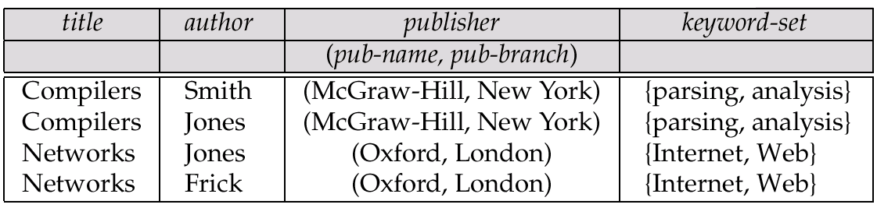
A Partially Nested Version of the flat-books Relation

